Slide 1
The Discovery of Novel Biomarkers using Multivariate Regression in a Lithium-treated Bipolar Cohort
By Kwek Dan Yi Germaine

Slide 2
Background Information
Different omics types(e.g. genome, proteome) interact to cause psychiatric disorders
Need to consider their interactions to have a holistic understanding of these disorders

Slide 3
Past Research
Supervised learning techniques to analyse multi-omics data
Focuses on single-layer networks from just one omics type
Uses simple integration methods
Does not consider the interactions between different omics
Incomplete

Slide 4
Solution
Unsupervised learning techniques such as Joint Dimensionality Reduction (JDR)
Regularised Generalised Canonical Correlation Analysis (RGCCA) is a JDR technique
Algorithm considers relationships between different data blocks and …
… solves the problem of dimensionality >>> observations by …
… jointly converting the high-dimensional datasets into a lower-dimensional space

Slide 5
Downstream Analyses
Cluster analysis to stratify patients
Identification of disease subtypes, patient subgroups and prediction of clinical outcomes

Slide 6
Psychiatric Disorders
Bipolar Disorder and Schizophrenia

Slide 7
Number of principal components
133 for 80% of the variation

Slide 8
Comparing Classifier Performance
Unable to classify the entire dataset of all 55 000+ genes as it was too large
Used subsets
First, I wanted to see if the low variance genes would decrease classifier performance
Then, I wanted to see if PCA could address that
I ranked the genes in order of variance

Slide 9
Genes with the top 10 000 variances (constant) and:
10 000 - 12 000: 36%
16 000 - 18 000: 40%
24 000 - 26 000: 41%
30 000 - 32 000: 38%
34 000 - 36 000: 34%
38 000 - 40 000: 29%, with pca: 39%
40 000 - 42 000: 22%, with pca: 39%
42 000 - 44 000: 15%, with pca: 41%
46 000 - 48 000: 10%, with pca: 33%
.
.
.
last 2000: 8%, with pca: 35%

Slide 10
Comparing Classifier Performance
PCA helps to negate the effects of the low-variance genes

Slide 11
Accumulated effect:
top 10 000 genes and:
32 000 - 34 000: 37%
32 000 - 36 000: 25%
32 000 - 38 000: 18%
32 000 - 38 500: 19%
Accuracy starts to drop when more low-variance genes are placed together.

Slide 12
Comparing Classifier Performance
Then, I wanted to see if PCA would have any negative effects on the high-variance genes.

Slide 13
High variance genes:
top 10 000: 38%, with pca: 52%
top 12 000: 36%, with pca: 50%
top 14 000: 42%, with pca: 47%
top 16 000: 41%, with pca: 48%
top 16 500: 34%, with pca: 40%
PCA does not hurt the accuracy.

Slide 14
Comparing Classifier Performance
PCA does not hurt the classifier performance of high-variance genes.
PCA helps address the negative effects of low-variance genes.
PCA is safe to use.

Slide 15
Clustering
Empirically determined: 12 clusters
Was not able to get very good clusters.
Any tricks that can be used to improve clustering?

Slide 16
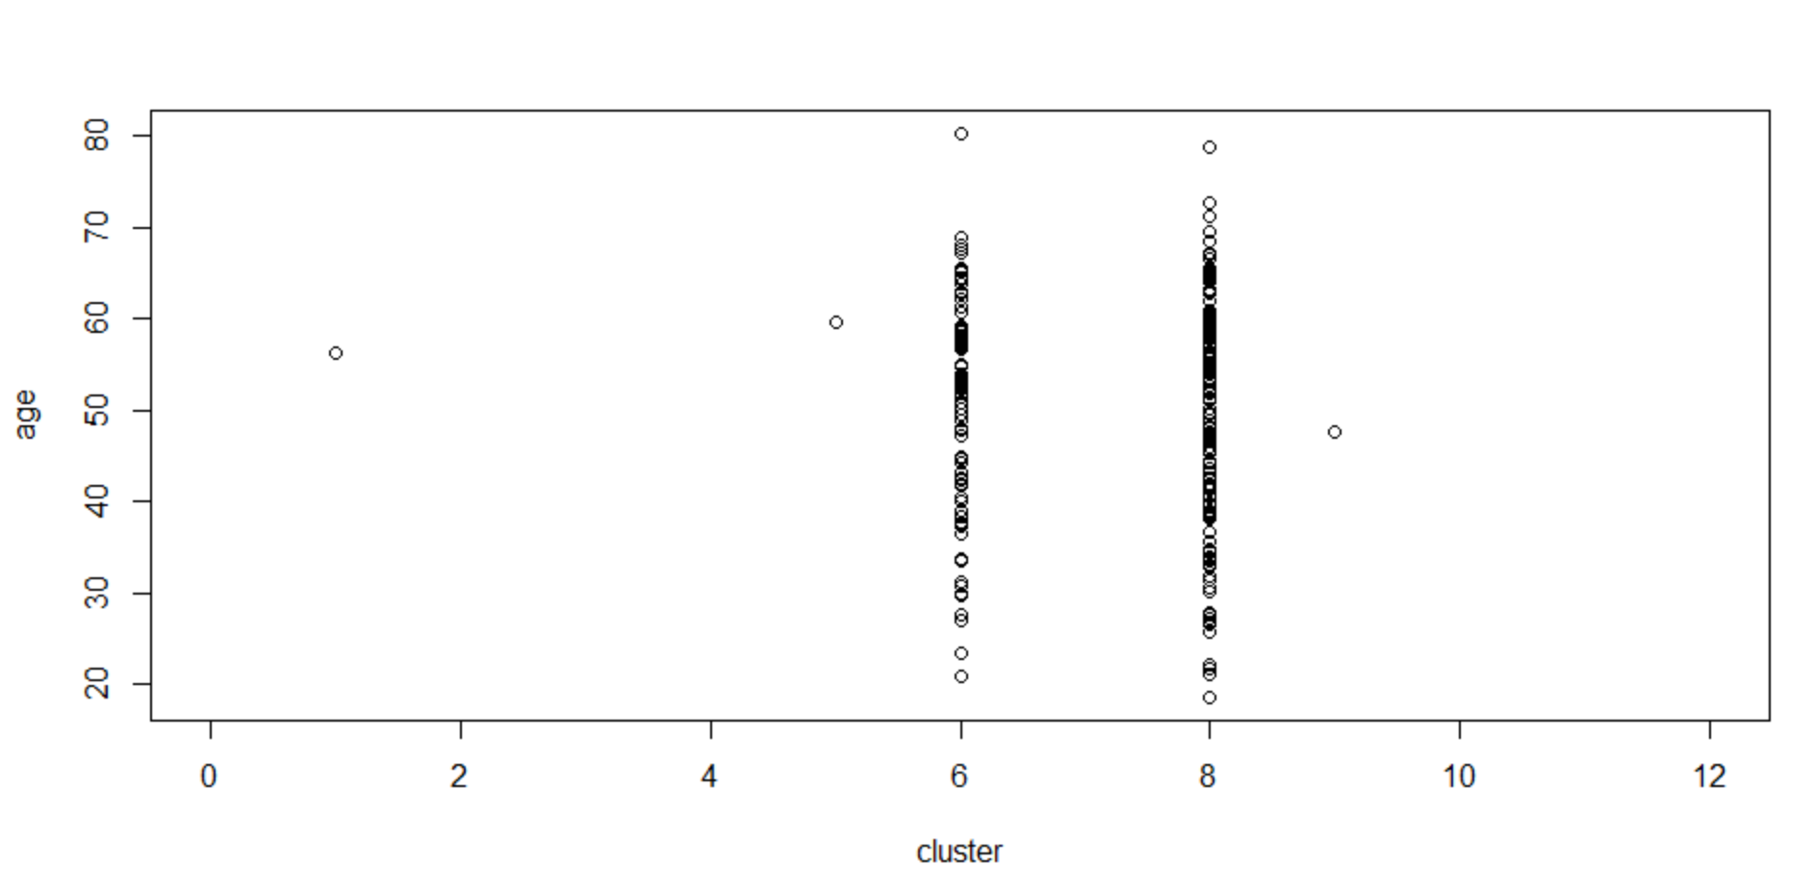
Clustering

Slide 17
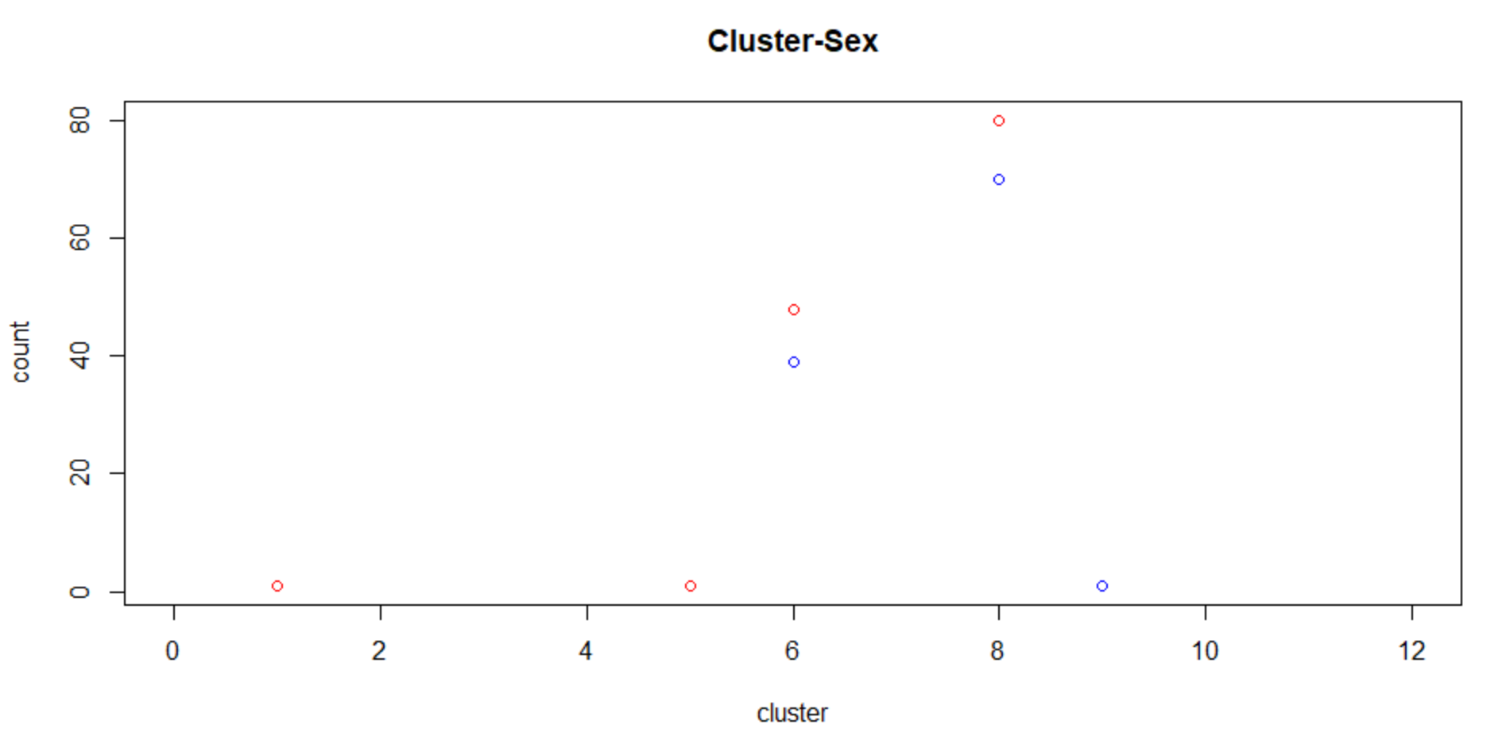
Clustering

Slide 18
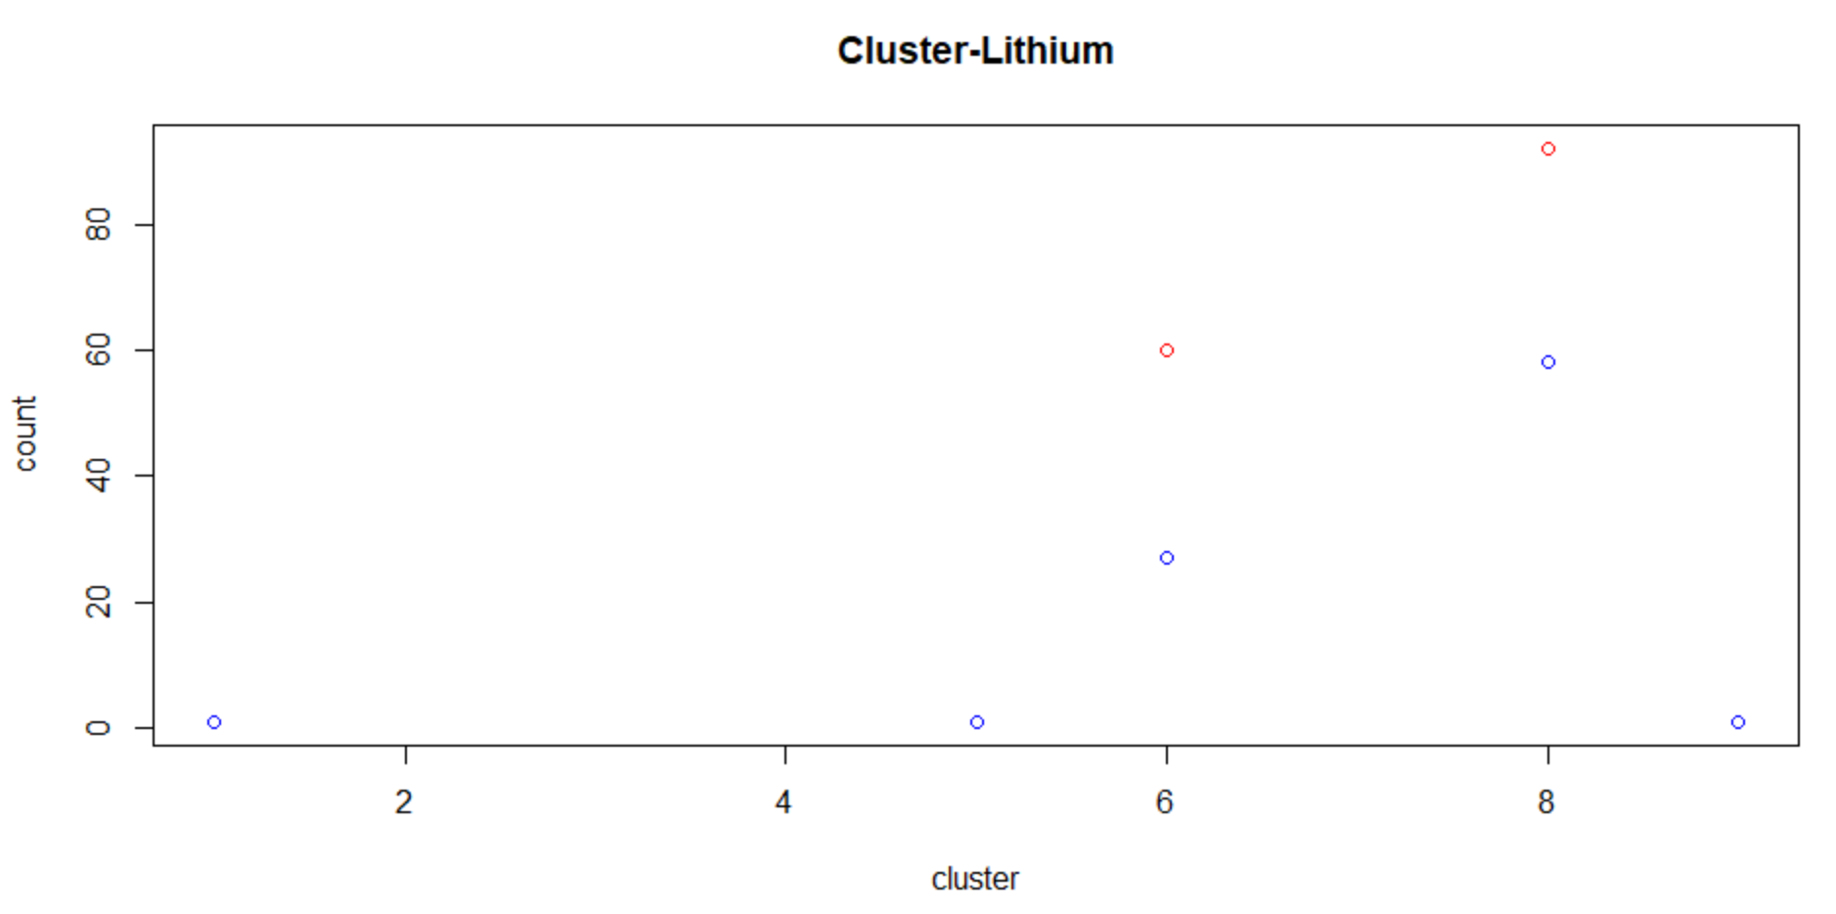
Clustering

Slide 19
F-test
Checked Yanxi’s results (with FDR correction): same results

Slide 20
PCA
Performed PCA on the 3000+ genes, capturing 90% of the total variation

Slide 21
Classification Accuracy
With 5-fold cross-validation
logistic regression with pca: 80%
logistic regression without pca: 48% (prediction from a rank-deficient fit may be misleading, genes > samples)
svm with pca: 83%
svm without pca: 85%

Slide 22
Kmeans Clustering
3 clusters by Elbow Method

Slide 23
GSEA
The cancer gene neighbourhoods collection shows significant results
Some gene sets in this collection show significant enrichment
Visualised such gene sets using Cytoscape’s Enrichment Map
Main cluster seen

Slide 24
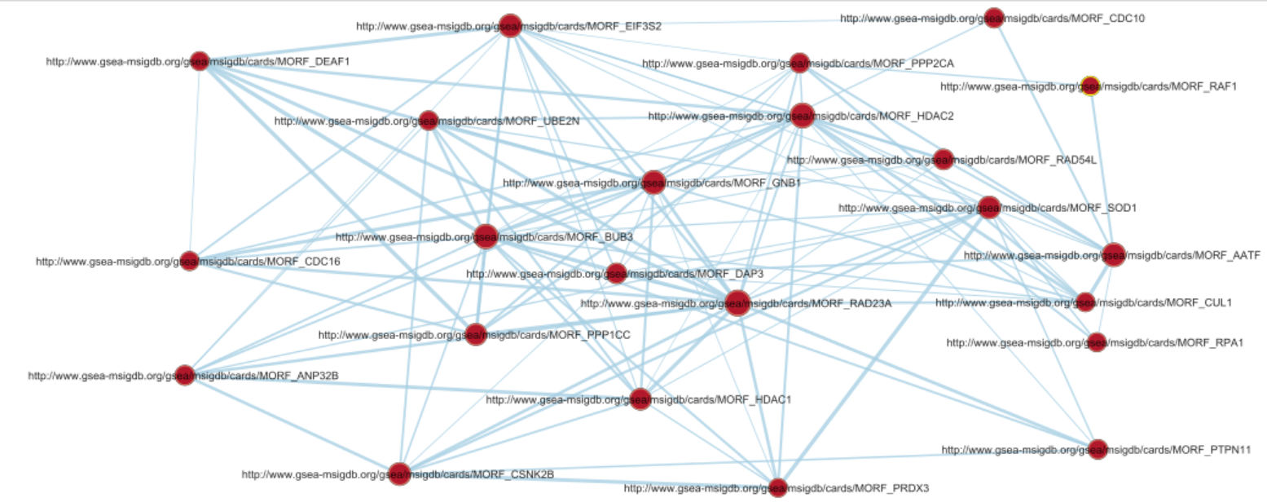
GSEA

Slide 25
GSEA
Nodes represent gene sets
Edges mean that two gene sets have genes in common
Main cluster of gene sets that share common genes
Makes sense that their names would all start with MORF
So this ‘MORF’ cluster shows significant enrichment in one patient subtype compared to another
So far: defined the patient subtypes and their differences
Next step: further explore those differences by investigating the ‘MORF’ cluster

